Slide 1
Stat 495r – Presenting Data
Week 7 – R Markdown

Slide 2
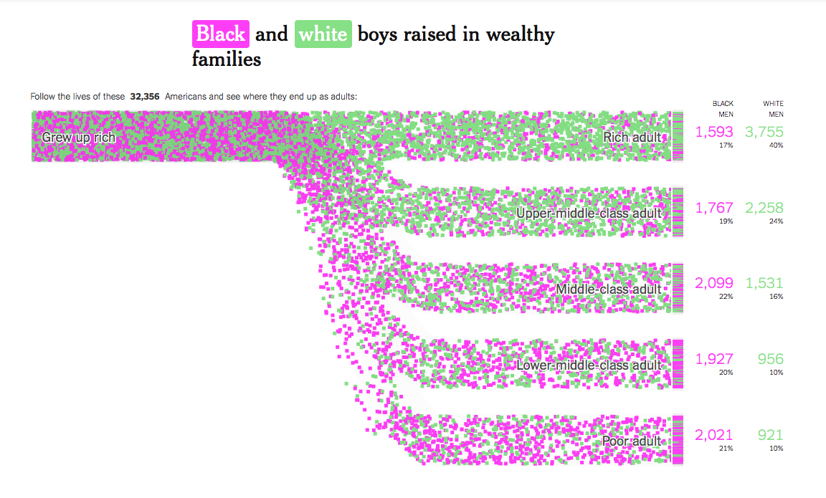
Data Viz #1
Notes:
What’s missing? (The ratio of black/white to start) What’s done well? Use of color
What’s done poorly? Labels and percentages, headline
What are the channels?

Slide 3
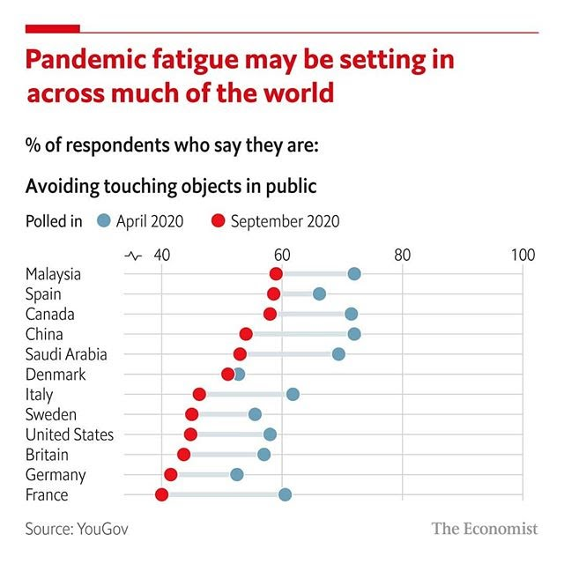
Data Viz #2
Notes:
Good tagline
Cited source
Cited question
Not a bar chart!
Squiggle for non-0 X-Axis starting paoint

Slide 4
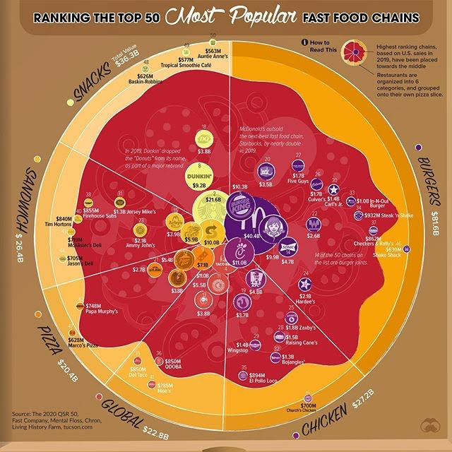
Data Viz #3
Notes:
A lot of information and color, but fun
If you could do this different, how would you do it?

Slide 5
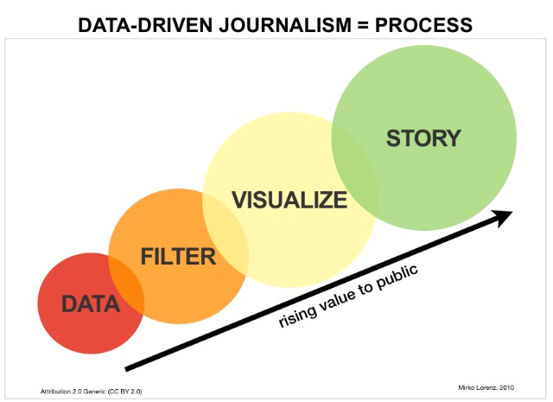
Quote of the Week
Notes:
Consider this when removing chart junk

Slide 6
Homework 8 Challenge

Slide 7
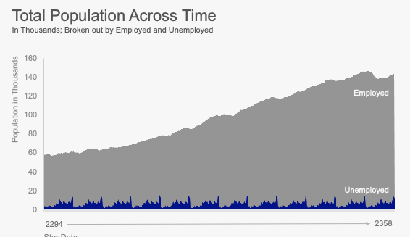
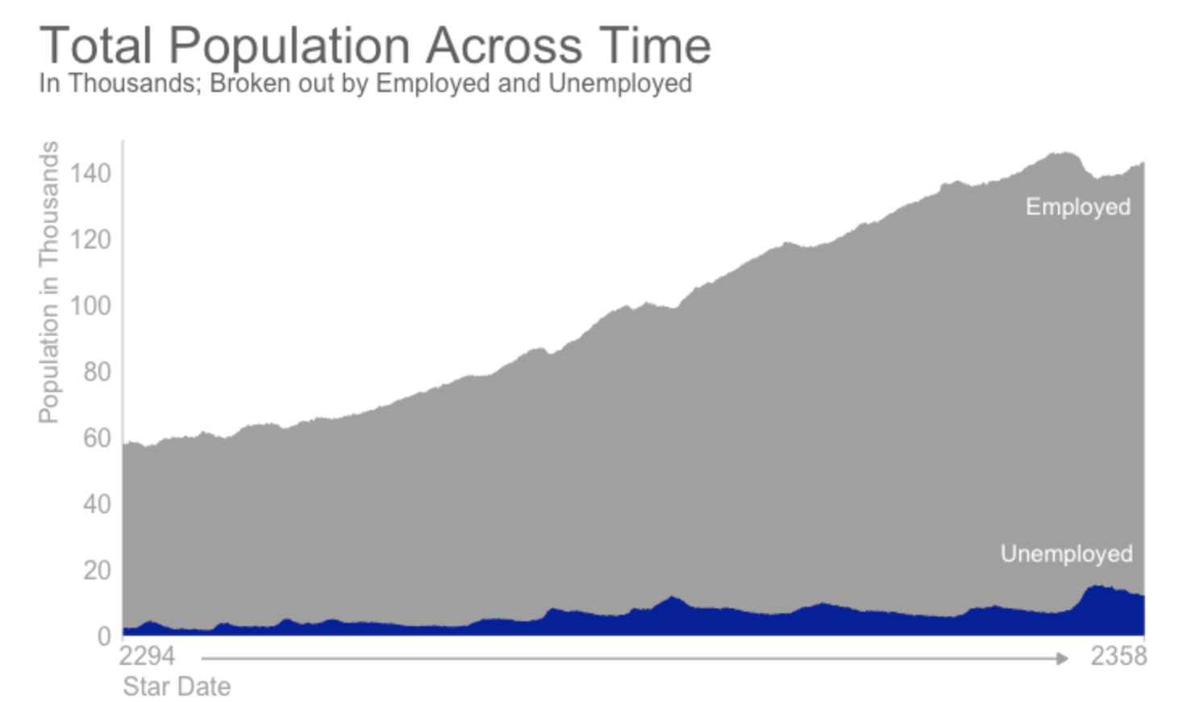
Chart 1
See code in the Notebook saved in the files

Slide 8
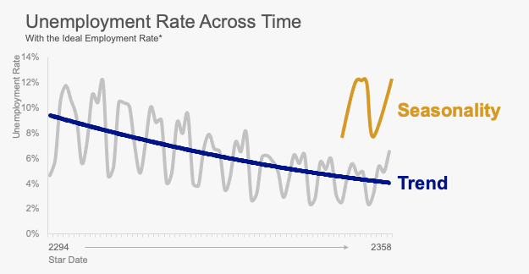
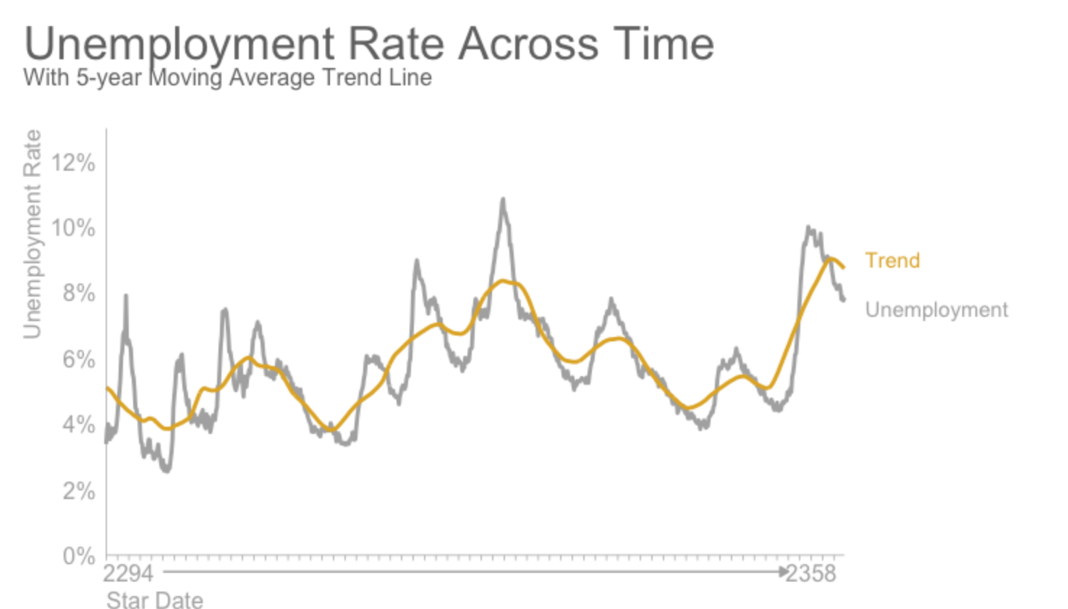
Chart 2

Slide 9
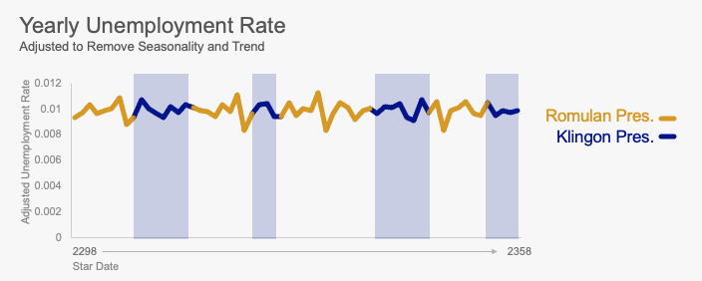
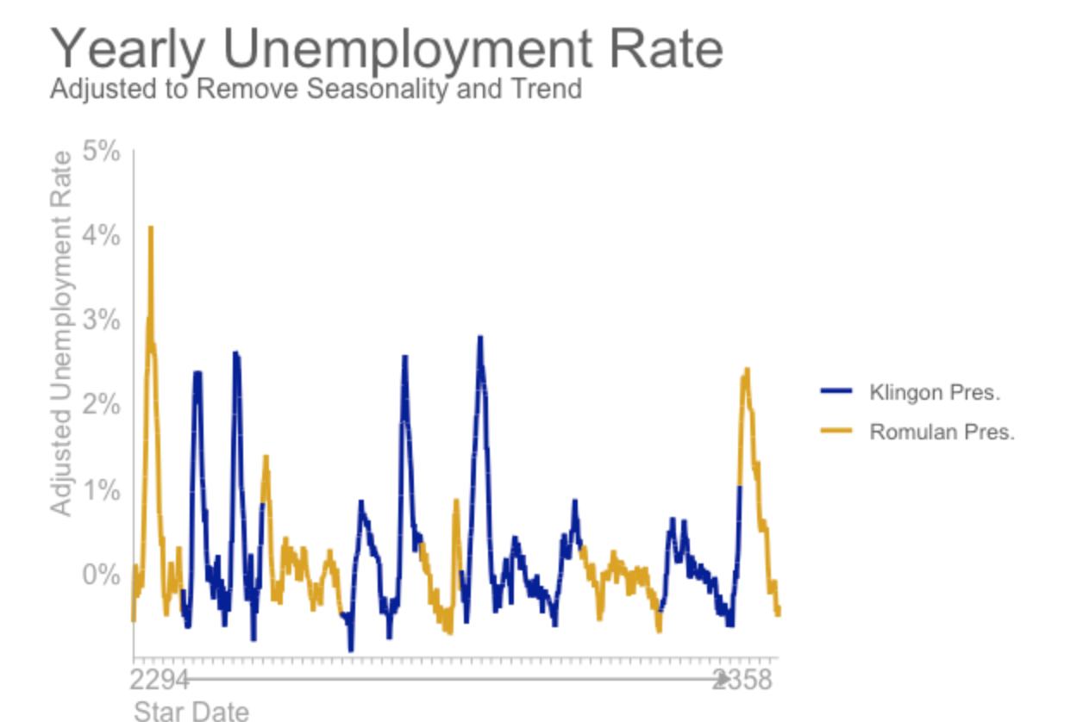
Chart 3

Slide 10
Homework

Slide 11
Homework 1
Implement the Jeff’s feedback on your Deseret News graphics
Use whatever tool you want (including mixing tools like R and PowerPoint)
The bold tagline should tell the story of the visual
Make use of pre-attentive devices (call-outs and annotations)
Cite the source and question text (who conducted the poll, for whom, when, who were polled)
Use muted grey text to push non-important details to the background
Use bold dark colors to pull the critical details to the foreground
Save the file as PNG and host your image on GitHub
Send me an URL of visualization (hosted as a PNG), exactly like it would be published online or in a newspaper

Slide 12
HW1 Assignments
Student | Graphic Assignment
Zach | Remote WorkWins-01.jpg
Annie | 0913P2graphic-01.jpg
Parker | Trump August poll2-01.jpg
Jenny Beth | Run-off poll-01.jpg
Kolby | Trump August poll-01.jpg
Kylee | 0906P2graphic-01.jpg
Kate | vaccinedistribution2-02.jpg
Matt | 0906P2graphic-01.jpg
Back-up | 0823P2graphic-01.jpg
Back-up | august heat-02.jpg

